Slide 1


Facebook's Newsfeed
Product Managers - KO Team
Samar Ashray
Mohamed Sobhy
Mary Girgis
Abdullah Fareed Johar

Slide 2
Facebook’s Newsfeed Idea screening
New Product Feature Detailed Overview
1
2
Understanding Customer needs
Facebook’s Newsfeed
Product Wireframes
3
4
Success Metrics
Terllo Board
5
6
Product Roadmaps

Slide 3
The New product Feature Details Overview
Loyalty points (Earning rewards points) for each user interaction, and the user can use it for paying anything he needs from the Facebook marketplace.
Users can set preferences to show all at the top of the Newsfeed.
Detect the preferred language of the user from the application setting and translate all of the Facebook content to this language.
Change the icon of " show translation " from the bottom of the post to be on the top to be more reusable and visible and easy to use anytime without reaching the post end to show the translation.

Slide 4
Understanding Customer needs
What they do? encourage customer interactions
Step 01
How they do? Earning rewards points,set user preferences
Understand your customer need by prioritizing social updates and actions
Step 03
Step 02
What Customer Expected? show his/her preferences first , collect more points
Step 04

Slide 5
New Product Feature Challenges
Challenge 1
Solution 1
Encouraging interactions over passiveness
Loyalty points (Earning rewards points) for each user interaction, and the user can use it for paying anything he needs from the Facebook marketplace.

Slide 6
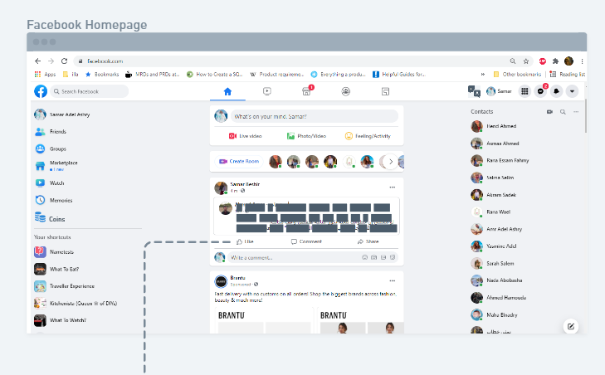
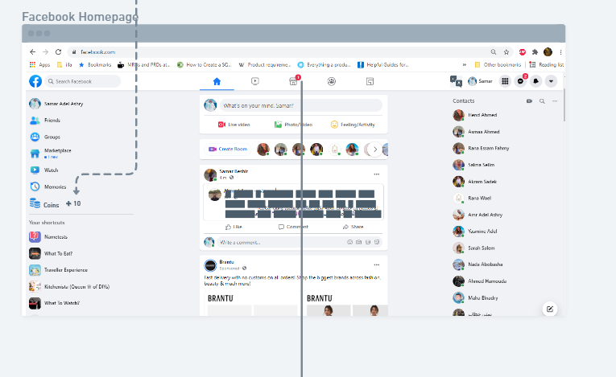
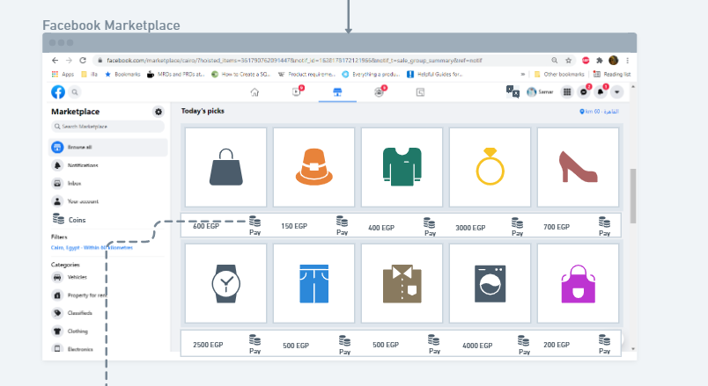
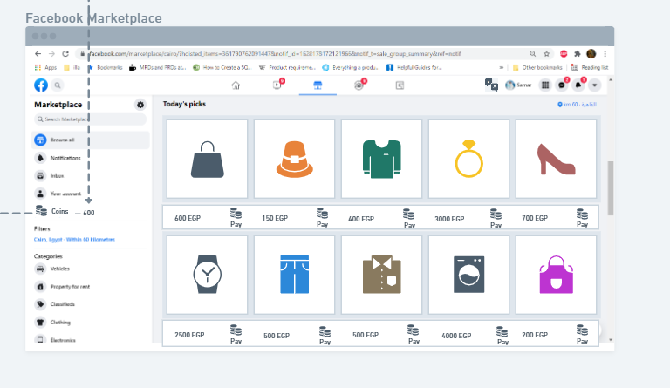
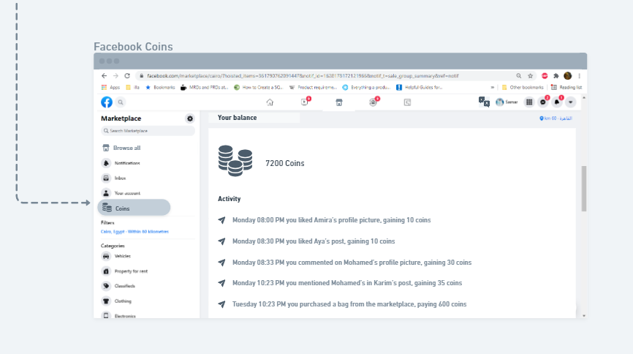
Wireframe Challenge 1
https://whimsical.com/encouraging-interactions-loyalty-program-LBfwBzfHt3dC8YoYu8f9Fo
1
2
4
5
3
Notes:
https://whimsical.com/encouraging-interactions-loyalty-program-LBfwBzfHt3dC8YoYu8f9Fo

Slide 7
New Product Feature Challenges
Challenge 2
Solution 2
Prioritizing social updates and actions
Users can set preferences to show all at the top of the Newsfeed.

Slide 8
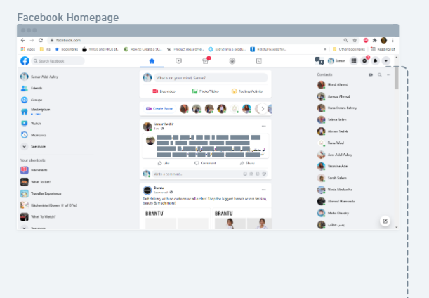
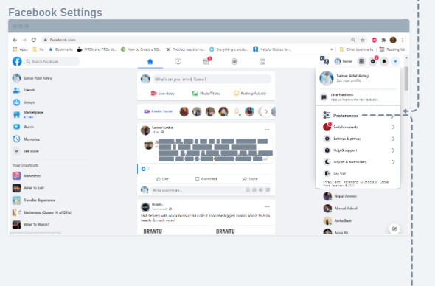
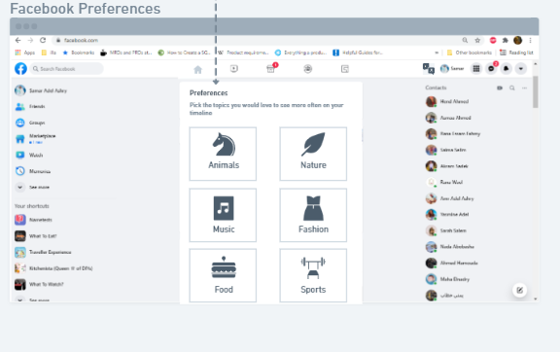
Wireframe Challenge 2
https://whimsical.com/encouraging-interactions-preferences-selection-Ct5WKjVCH2TgXER9mDSBRb
1
2
3

Slide 9
New Product Feature Challenges(Cont.)
Challenge 3
Solution 3
Presenting all content with preferred language
Detect the preferred language of the user from the application setting and translate all of the Facebook content to this language.

Slide 10
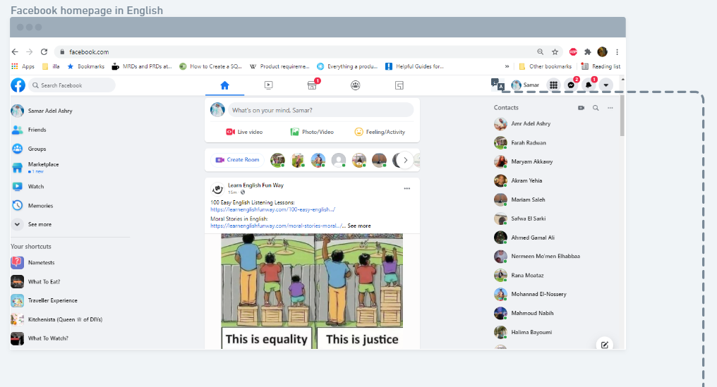
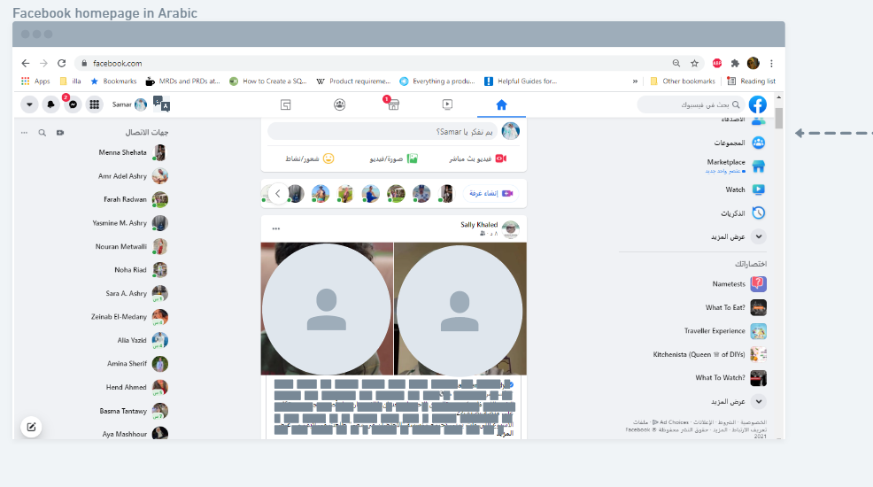
Wireframe Challenge 3
https://whimsical.com/localization-localizing-product-language-UaYxBkM1X8VBpSsV56r35V
1
2

Slide 11
New Product Feature Challenges(Cont.)
Challenge 4
Solution 4
Translations appears at the bottom post which make it hard to reach
Change the icon of " show translation " from the bottom of the post to be on the top to be more reusable and visible and easy to use anytime without reaching the post end to show the translation.

Slide 12
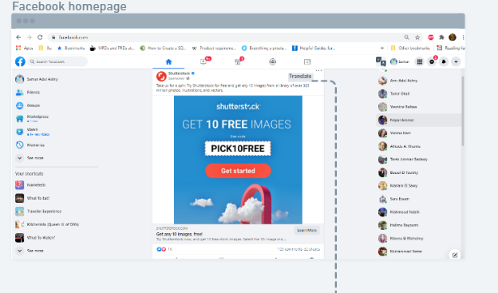
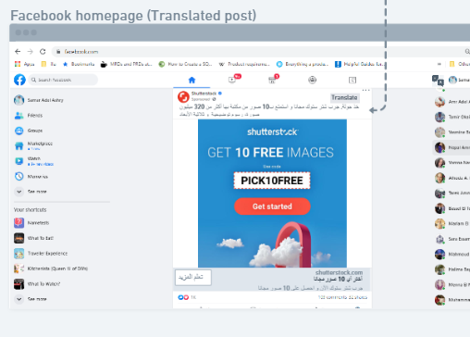
Wireframe Challenge 4
https://whimsical.com/localization-translating-content-8XT8mA3HMRm6TfigiuC2Fa
1
2

Slide 13
The Solution Wireframes
https://whimsical.com/encouraging-interactions-loyalty-program-LBfwBzfHt3dC8YoYu8f9Fo
https://whimsical.com/encouraging-interactions-preferences-selection-Ct5WKjVCH2TgXER9mDSBRb
https://whimsical.com/localization-localizing-product-language-UaYxBkM1X8VBpSsV56r35V
https://whimsical.com/localization-translating-content-8XT8mA3HMRm6TfigiuC2Fa

Slide 14
The Success Metrics
Facebook currently has 2.701 billion monthly active users (MAUs).
By the end of first Q we will increase the average spending time 4 min more.
We targeted 5% of monthly users to be daily user after adding the features.
By Loyalty points we will increase the user interaction, and the user can use it for paying anything she / he needs from facebook
This will be possible cause the highest age in facebook is between 18-49 who usually scroll through the newsfeed
We will focus to attract the highest markets in facebook by Detecting there preferred language .
According to the latest data, the country with the most Facebook users is India with over 290 million active users, followed by the US (190 million), Indonesia (140 million), Brazil (130 million), and Mexico (89 million).

Slide 15
The New Product Feature Life Cycle Stage
Introduction
Growth
Maturity
Decline
new feature Development and Testing
Maintenance and Technical Support
Enhancement and Feature Implementation
R&D and Migriating

Slide 16
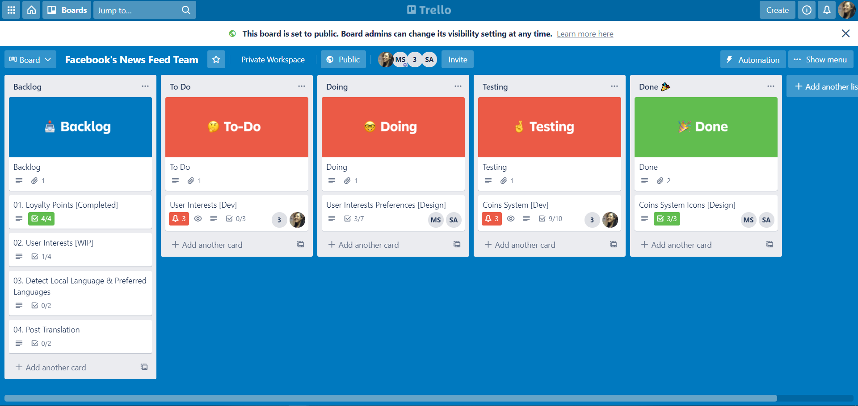
Trello Board Backlog
https://trello.com/b/KYXfaf77/facebooks-news-feed-team

Slide 17
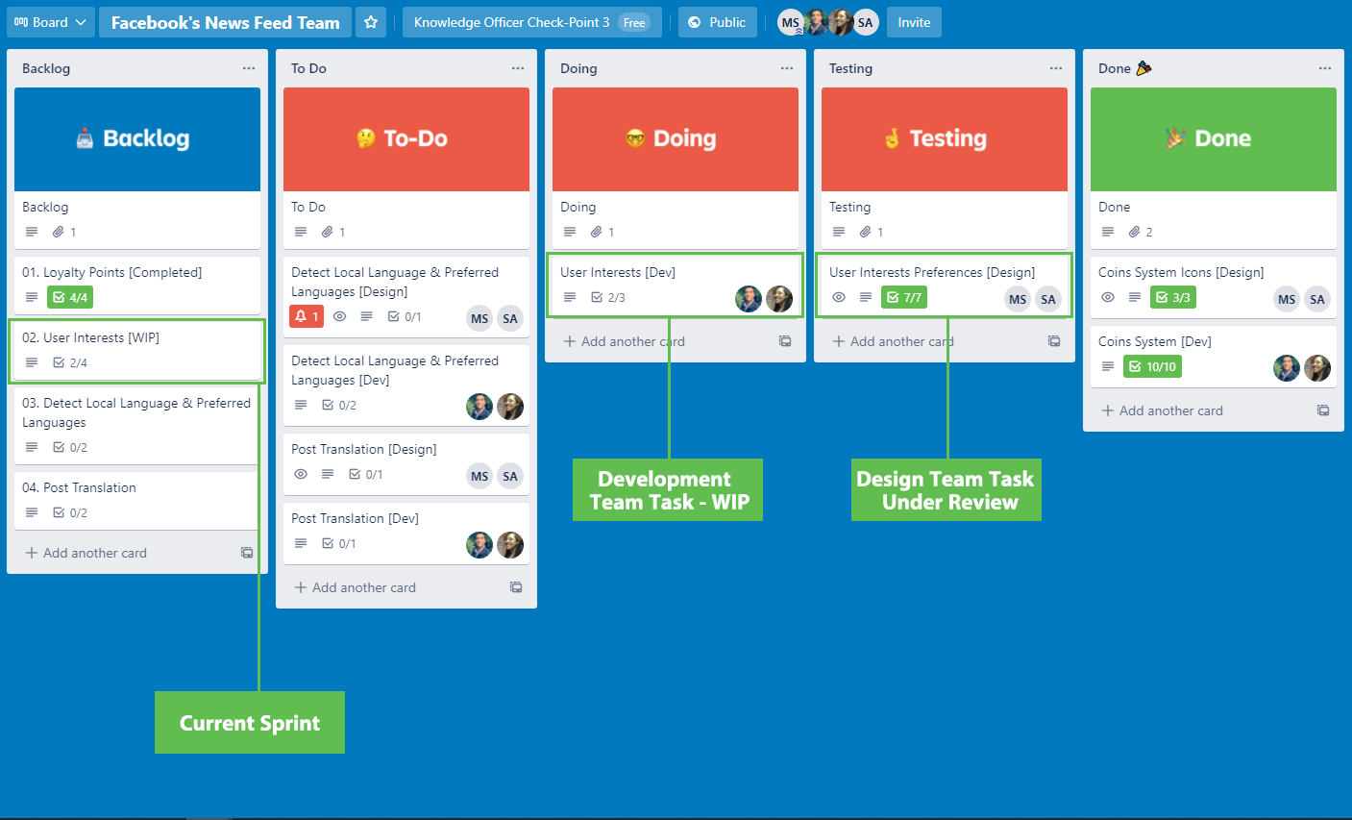
Trello Board Sprint
Features Sprints
Loyalty Points : Two Week
User Interests : Two Weeks
Local Language : One Week
Post Translation : One Week

Slide 18
New Product Feature Roadmap
Sprint 01
Loyalty Coins
Sprint 02
User Interests
Sprint 04
Post Translation
Sprint 03
Local Language
01
02
04
03

